Slide 1
Transmission Fundamentals
Chapter 1

Slide 2
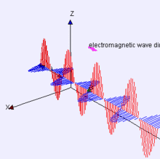
Electromagnetic Signal
Function of time
Can also be expressed as a function of frequency
  Signal consists of components of different frequencies

Slide 3
Time-Domain Concepts
Analog signal - signal intensity varies in a smooth fashion over time
  No breaks or discontinuities in the signal
Digital signal - signal intensity maintains a constant level for some period of time and then changes to another constant level
Periodic signal - analog or digital signal pattern that repeats over time
  s(t +T ) = s(t ) -T/2 < t < T/2
    where T is the period of the signal

Slide 4
Time-Domain Concepts
Aperiodic signal - analog or digital signal pattern that doesn't repeat over time
Peak amplitude (A) - maximum value or strength of the signal over time; typically measured in volts
Frequency (f )
  Rate, in cycles per second, or Hertz (Hz) at which the signal repeats

Slide 5
Time-Domain Concepts
Period (T ) - amount of time it takes for one repetition of the signal
  T = 1/f
Phase (φ) - measure of the relative position in time within a single period of a signal
Wavelength (λ) - distance occupied by a single cycle of the signal
  Or, the distance between two points of corresponding phase of two consecutive cycles

Slide 6
Sine Wave Parameters
General sine wave
  s(t ) = A sin(2πft + φ)
Figure 2.3 shows the effect of varying each of the three parameters
  (a) A = 1, f = 1 Hz, φ = 0; thus T = 1s
  (b) Reduced peak amplitude; A=0.5
  (c) Increased frequency; f = 2, thus T = ½
  (d) Phase shift; φ = π/4 radians (45 degrees)
note: 2π radians = 360° = 1 period

Slide 7
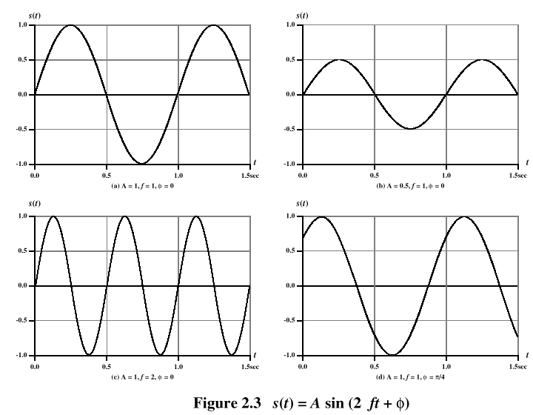
Sine Wave Parameters

Slide 8
Time vs. Distance
When the horizontal axis is time, as in Figure 2.3, graphs display the value of a signal at a given point in space as a function of time
With the horizontal axis in space, graphs display the value of a signal at a given point in time as a function of distance
  At a particular instant of time, the intensity of the signal varies as a function of distance from the source

Slide 9
Frequency-Domain Concepts
Fundamental frequency - when all frequency components of a signal are integer multiples of one frequency, it’s referred to as the fundamental frequency
Spectrum - range of frequencies that a signal contains
Absolute bandwidth - width of the spectrum of a signal
Effective bandwidth (or just bandwidth) - narrow band of frequencies that most of the signal’s energy is contained in

Slide 10
Frequency-Domain Concepts
Any electromagnetic signal can be shown to consist of a collection of periodic analog signals (sine waves) at different amplitudes, frequencies, and phases
The period of the total signal is equal to the period of the fundamental frequency

Slide 11
Relationship between Data Rate and Bandwidth
The greater the bandwidth, the higher the information-carrying capacity
Conclusions
  Any digital waveform will have infinite bandwidth
  BUT the transmission system will limit the bandwidth that can be transmitted
  AND, for any given medium, the greater the bandwidth transmitted, the greater the cost
  HOWEVER, limiting the bandwidth creates distortions

Slide 12
Data Communication Terms
Data - entities that convey meaning, or information
Signals - electric or electromagnetic representations of data
Transmission - communication of data by the propagation and processing of signals

Slide 13
Examples of Analog and Digital Data
Analog
  Video
  Audio
Digital
  Text
  Integers

Slide 14
Analog Signals
A continuously varying electromagnetic wave that may be propagated over a variety of media, depending on frequency
Examples of media:
  Copper wire media (twisted pair and coaxial cable)
  Fiber optic cable
  Atmosphere or space propagation
Analog signals can propagate analog and digital data

Slide 15
Digital Signals
A sequence of voltage pulses that may be transmitted over a copper wire medium
Generally cheaper than analog signaling
Less susceptible to noise interference
Suffer more from attenuation
Digital signals can propagate analog and digital data

Slide 16
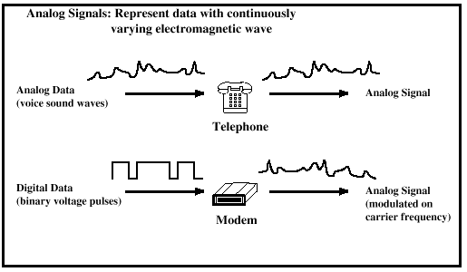
Analog Signaling

Slide 17
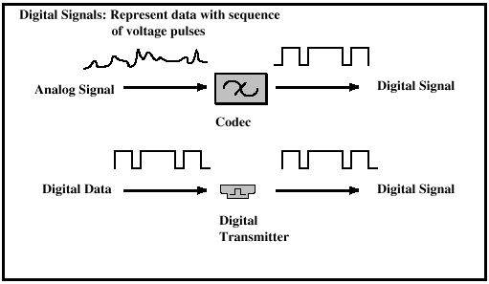
Digital Signaling

Slide 18
Reasons for Choosing Data and Signal Combinations
Digital data, digital signal
  Equipment for encoding is less expensive than digital-to-analog equipment
Analog data, digital signal
  Conversion permits use of modern digital transmission and switching equipment
Digital data, analog signal
  Some transmission media will only propagate analog signals
  Examples include optical fiber and satellite
Analog data, analog signal
  Analog data easily converted to analog signal

Slide 19
Analog Transmission
Attenuation limits length of transmission link
Cascaded amplifiers boost signal’s energy for longer distances but cause distortion
  Analog data can tolerate distortion
  Introduces errors in digital data

Slide 20
Digital Transmission
Attenuation endangers integrity of data
Digital Signal
  Repeaters achieve greater distance
  Repeaters recover the signal and retransmit
Analog signal carrying digital data
  Retransmission device recovers the digital data from analog signal
  Generates new, clean analog signal

Slide 21
About Channel Capacity
Impairments, such as noise, limit data rate that can be achieved
For digital data, to what extent do impairments limit data rate?
Channel Capacity – the maximum rate at which data can be transmitted over a given communication path, or channel, under given conditions

Slide 22
Concepts Related to Channel Capacity
Data rate - rate at which data can be communicated (bps)
Bandwidth - the bandwidth of the transmitted signal as constrained by the transmitter and the nature of the transmission medium (Hertz)
Noise - average level of noise over the communications path
Error rate - rate at which errors occur
  Error = transmit 1 and receive 0; transmit 0 and receive 1

Slide 23
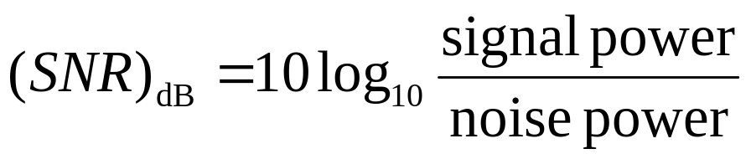
Signal-to-Noise Ratio
Ratio of the power in a signal to the power contained in the noise that’s present at a particular point in the transmission
Typically measured at a receiver
Signal-to-noise ratio (SNR, or S/N)
A high SNR means a high-quality signal, low number of required intermediate repeaters
SNR sets upper bound on achievable data rate

Slide 24
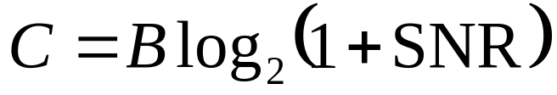
Shannon Capacity Formula
Equation:
Represents theoretical maximum that can be achieved
In practice, only much lower rates achieved
  Formula assumes white noise (thermal noise)
  Impulse noise is not accounted for
  Attenuation distortion or delay distortion not accounted for

Slide 25
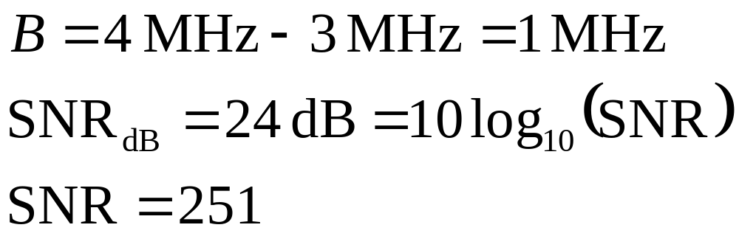
Example of Shannon Formulation
Spectrum of a channel between 3 MHz and 4 MHz ; SNR_{dB} = 24 dB
Using Shannon’s formula

Slide 26
Classifications of Transmission Media
Transmission Medium
  Physical path between transmitter and receiver
Guided Media
  Waves are guided along a solid medium
  E.g., copper twisted pair, copper coaxial cable, optical fiber
Unguided Media
  Provides means of transmission but does not guide electromagnetic signals
  Usually referred to as wireless transmission
  E.g., atmosphere, outer space

Slide 27
Unguided Media
Transmission and reception are achieved by means of an antenna
Configurations for wireless transmission
  Directional
  Omnidirectional

Slide 28
General Frequency Ranges
Microwave frequency range
  1 GHz to 40 GHz
  Directional beams possible
  Suitable for point-to-point transmission
  Used for satellite communications
Radio frequency range
  30 MHz to 1 GHz
  Suitable for omnidirectional applications
Infrared frequency range
  Roughly, 3x10¹¹ to 2x10¹⁴ Hz
  Useful in local point-to-point multipoint applications within confined areas

Slide 29
Terrestrial Microwave
Description of common microwave antenna
  Parabolic "dish", 3 m in diameter
  Fixed rigidly and focuses a narrow beam
  Achieves line-of-sight transmission to receiving antenna
  Located at substantial heights above ground level
Applications
  Long haul telecommunications service
  Short point-to-point links between buildings

Slide 30
Satellite Microwave
Description of communication satellite
  Microwave relay station
  Used to link two or more ground-based microwave transmitter/receivers
  Receives transmissions on one frequency band (uplink), amplifies or repeats the signal, and transmits it on another frequency (downlink)
Applications
  Television distribution
  Long-distance telephone transmission
  Private business networks

Slide 31
Broadcast Radio
Description of broadcast radio antennas
  Omnidirectional
  Antennas not required to be dish-shaped
  Antennas need not be rigidly mounted to a precise alignment
Applications
  Broadcast radio
    VHF and part of the UHF band; 30 MHZ to 1GHz
    Covers FM radio and UHF and VHF television

Slide 32
Multiplexing
Capacity of transmission medium usually exceeds capacity required for transmission of a single signal
Multiplexing - carrying multiple signals on a single medium
  More efficient use of transmission medium

Slide 33
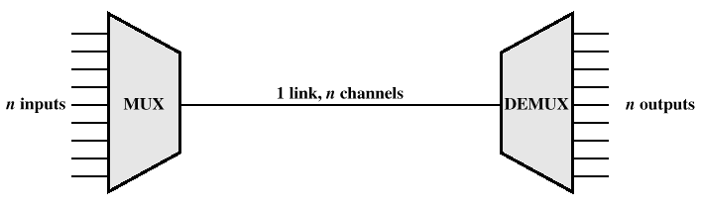
Multiplexing

Slide 34
Reasons for Widespread Use of Multiplexing
Cost per kbps of transmission facility declines with an increase in the data rate
Cost of transmission and receiving equipment declines with increased data rate
Most individual data communicating devices require relatively modest data rate support

Slide 35
Multiplexing Techniques
Frequency-division multiplexing (FDM)
  Takes advantage of the fact that the useful bandwidth of the medium exceeds the required bandwidth of a given signal
Time-division multiplexing (TDM)
  Takes advantage of the fact that the achievable bit rate of the medium exceeds the required data rate of a digital signal

Slide 36
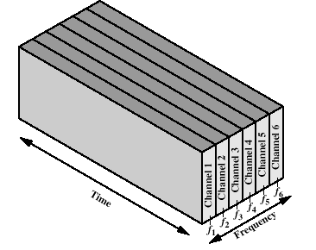
Frequency-division Multiplexing

Slide 37
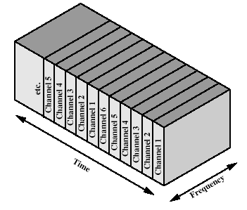
Time-division Multiplexing

